Slide 1
What are probability models?
A probability model is a mathematical representation of a random phenomenon. It is defined by its sample space, events within the sample space, and probabilities associated with each event. The sample space S for a probability model is the set of all possible outcomes.
Who is known as father of probability?
A gambler's dispute in 1654 led to the creation of a mathematical theory of probability by two famous French mathematicians, Blaise Pascal and Pierre de Fermat

Slide 2
Bayes' theorem allows updating the probability prediction of an event by observing new information of the real world.
Example: If cancer corresponds to one's age then by using Bayes' theorem, we can determine the probability of cancer more accurately with the help of age.
Bayes' theorem can be derived using product rule and conditional probability of event A with known event B:
As from product rule we can write:
P(A ⋀ B)= P(A|B) P(B) or
Similarly, the probability of event B with known event A:
P(A ⋀ B)= P(B|A) P(A)

Slide 3
What are the 3 axioms of probability?
For any event A, P(A) ≥ 0. In English, that's “For any event A, the probability of A is greater or equal to 0”.
When S is the sample space of an experiment; i.e., the set of all possible outcomes, P(S) = 1.
If A and B are mutually exclusive outcomes, P(A 𝖴 B ) = P(A) + P(B).

Slide 4
Conditional Probability
Conditional probability is a probability of occurring an event when another event has already happened.
Let's suppose, we want to calculate the event A when event B has already occurred, "the probability of A under the conditions of B", it can be written as:
Where P(A⋀B)= Joint probability of A and B
P(B)= Marginal probability of B.

Slide 5
INDEPENDENT EVENTS & DEPENDENT EVENTS
Events can be "Independent", meaning each event is not affected by any other events.
But events can also be "dependent" ... which means they can be affected by previous events

Slide 6
Bayes Rule
Bayes' theorem is also known as Bayes' rule, Bayes' law, or Bayesian reasoning, which determines the probability of an event with uncertain knowledge.
In probability theory, it relates the conditional probability and marginal probabilities of two random events.
Bayes' theorem was named after the British mathematician Thomas Bayes. The Bayesian inference is an application of Bayes' theorem, which is fundamental to Bayesian statistics.
It is a way to calculate the value of P(B|A) with the knowledge of P(A|B).

Slide 7
Equating right hand side of both the equations, we will get:
The above equation is called as Bayes' rule or Bayes' theorem. This equation is basic of most modern AI systems for probabilistic inference.
It shows the simple relationship between joint and conditional probabilities. Here,
P(A|B) is known as posterior, which we need to calculate, and it will be read as Probability of hypothesis A when we have occurred an evidence B.
P(B|A) is called the likelihood, in which we consider that hypothesis is true, then we calculate the probability of evidence.

Slide 8

Applying Bayes' Rule:
Bayes' rule allows us to compute the single term P(B|A) in terms of P(A|B), P(B), and P(A). This is very useful in cases where we have a good probability of these three terms and want to determine the fourth one. Suppose we want to perceive the effect of some unknown cause, and want to compute that cause, then the Bayes' rule becomes:

Slide 9

EXAMPLES
Weather Forecast
Let’s say you want to figure out the probability that it will rain, given that the sky is cloudy. You know the following:
• P(Rain) = 0.3 (There’s a 30% chance of rain today).
• P(Cloudy | Rain) = 0.8 (When it rains, it’s cloudy 80% of the time).
• P(Cloudy | No Rain) = 0.2 (When it doesn’t rain, it’s cloudy only 20% of the time).
• P(No Rain) = 0.7 (70% chance of no rain).

Slide 10
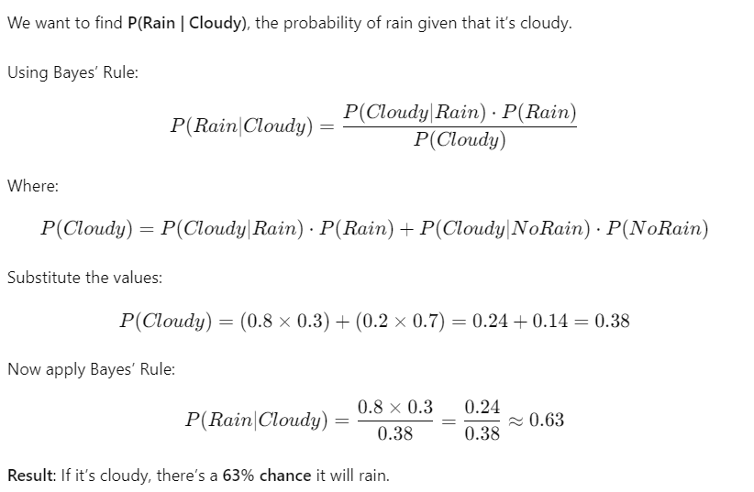
Question: what is the probability that a patient has diseases meningitis with a stiff neck?
GIVEN DATA
A doctor is aware that disease meningitis causes a patient to have a stiff neck, and it occurs 80% of the time. He is also aware of some more facts, which are given as follows:
The Known probability that a patient has meningitis disease is 1/30,000.
The Known probability that a patient has a stiff neck is 2%.
Let a be the proposition that patient has stiff neck and b be the proposition
that patient has meningitis. , so we can calculate the following as:
P(a|b) = 0.8
P(b) = 1/30000
P(a)= 0.02

Slide 11


Question: From a standard deck of playing cards, a single card is drawn. The probability that the card is king is 4/52, then calculate posterior probability P(King|Face), which means the drawn face card is a king card.
Solution:

Slide 12
Bayesian Belief Network
Bayesian belief network is key computer technology for dealing with probabilistic events and to solve a problem which has uncertainty. We can define a Bayesian network as:
"A Bayesian network is a probabilistic graphical model which represents a set of variables and their conditional dependencies using a directed acyclic graph."
It is also called a Bayes network, belief network, decision network, or Bayesian model.
Bayesian networks are probabilistic, because these networks are built from a probability distribution, and also use probability theory for prediction and anomaly detection.
Real world applications are probabilistic in nature, and to represent the relationship between multiple events, we need a Bayesian network. It can also be used in various tasks including prediction, anomaly detection, diagnostics, automated insight, reasoning, time series prediction, and decision making under uncertainty.
Bayesian Network can be used for building models from data and experts opinions, and it consists of two parts:
Directed Acyclic Graph
Table of conditional probabilities.
The generalized form of Bayesian network that represents and solve decision problems under uncertain knowledge is known as an Influence diagram.

Slide 13
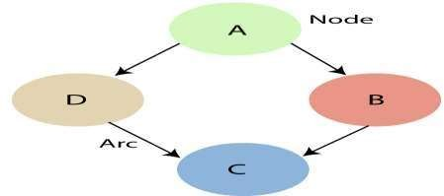
Each node corresponds to the random variables, and a variable can be continuous or discrete.
Arc or directed arrows represent the causal relationship or conditional probabilities between random variables. These directed links or arrows connect the pair of nodes in the graph. These links represent that one node directly influence the other node, and if there is no directed link that means that nodes are independent with each other
In the above diagram, A, B, C, and D are random variables represented by the nodes of the network graph.
If we are considering node B, which is connected with node A by a directed arrow, then node A is called the parent of Node B.
Node C is independent of node A.
The Bayesian network graph does not contain any cyclic graph. Hence, it is known as a directed acyclic graph or DAG.

Slide 14
The Bayesian network has mainly two components:
Causal Component
Actual numbers
Each node in the Bayesian network has condition probability distribution P(X_{i} |Parent(X_{i}) ), which determines the effect of the parent on that node.

Slide 15

Joint probability distribution:
If we have variables x1, x2, x3,....., xn, then the probabilities of a different combination of x1, x2, x3.. xn, are known as Joint probability distribution.
P[x₁, x₂, x₃,....., x_{n}], it can be written as the following way in terms of the joint probability distribution.
= P[x₁| x₂, x₃,....., x_{n}]P[x₂, x₃,....., x_{n}]
= P[x₁| x₂, x₃,....., x_{n}]P[x₂|x₃,....., x_{n}]....P[x_{n-1}|x_{n}]P[x_{n}].
In general for each variable Xi, we can write the equation as:

Slide 16
Example:
Harry installed a new burglar alarm at his home to detect burglary. The alarm reliably responds at detecting a burglary but also responds for minor earthquakes. Harry has two neighbors John and Marry, who have taken a responsibility to inform Harry at work when they hear the alarm. John always calls Harry when he hears the alarm, but sometimes he got confused with the phone ringing and calls at that time too. On the other hand, Marry likes to listen to high music, so sometimes she misses to hear the alarm. Here we would like to compute the probability of Burglary Alarm.

Slide 17
Calculate the probability that the alarm has sounded, but there is neither a burglary nor an earthquake, and both John and Marry called Harry.
Bayesian Network Structure:
• Burglary (B) and Earthquake (E) influence the Alarm (A).
• Alarm (A) influences John Calls (J) and Marry Calls (M).
Conditional Probability Tables (CPTs):
1. Burglary (B):
o P (B=True)=0.002
o P(B=False) =0.998 2. Earthquake (E):
o P(E=True) =0.001 o P(E=False)=0.999

Slide 18
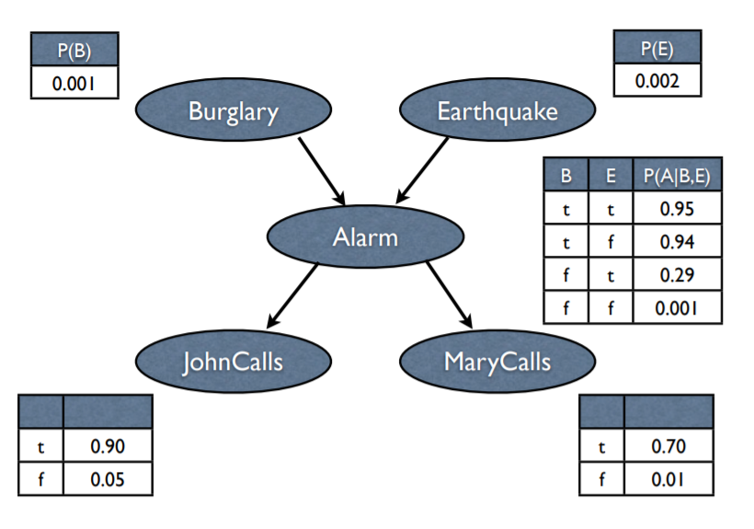





Slide 19
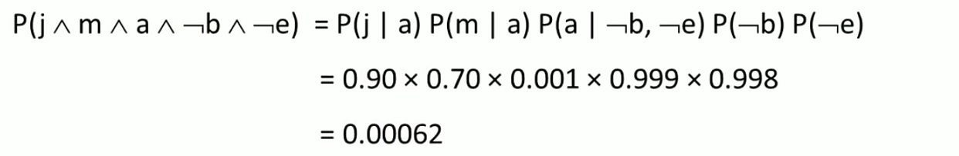

Slide 20
UTILITY BASED SYSTEM
These agents are similar to the goal-based agent but provide an extra component of utility measurement which makes them different by providing a measure of success at a given state Utility-based agent act based not only goals but also the best way to achieve the goal.
The Utility-based agent is useful when there are multiple possible alternatives, and an agent has to choose in order to perform
Utility theory in artificial intelligence is a mathematical framework used to model decision-making under uncertainty. It allows one to assign subjective values or preferences to different outcomes and helps make optimal choices based on these values. Utility theory is widely used in various AI applications such as game theory, economics, robotics, and recommendation systems, among others.

Slide 21
A utility function is a mathematical function used in Artificial Intelligence (AI) to represent a system's preferences or objectives. It assigns a numerical value, referred to as utility, to different outcomes based on their satisfaction level. It is used to guide decision-making in AI systems. An agent or system typically defines the utility function based on its goals, objectives, and preferences. It maps different outcomes to their corresponding utility values, where higher utility values represent more desirable outcomes.
The utility function is typically denoted as UU. It is a mathematical function that takes as input the different features of an outcome and maps them to a real-valued utility value. We can represent the utility function mathematically as U(x)U(x), where xx represents the attributes or features of an outcome.

Slide 23
Decision Making
One common approach in AI decision-making is to maximize the expected utility, which considers the probability of different outcomes occurring. The AI system chooses the action with the highest expected utility as the optimal choice.
Examples:
Self-Driving Cars: In the self-driving cars application, the utility function may consider factors such as time taken, fuel consumption, safety, and comfort, and assign utility values to different routes based on these factors.
Recommendation Systems: Consider a recommendation system that suggests movies to users based on their preferences.

Slide 24
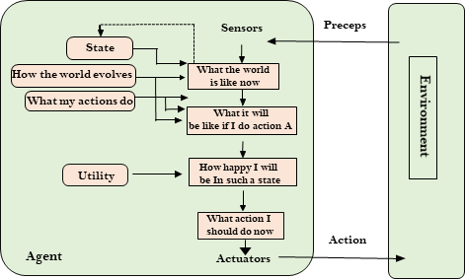

Slide 25
Components of Utility-Based Agents
1. Utility Function
A mathematical representation of the agent’s preferences,
assigning a utility value to each possible outcome.
o Purpose: Quantifies preferences, allowing the agent to compare states and
choose actions that maximize utility. For example, in an autonomous vehicle,
the utility function might consider safety, speed, fuel efficiency, and passenger
comfort.
2. State Space
o Definition: The set of all possible states the agent can be in.
o Purpose: Defines the environment in which the agent operates. Understanding
all possible states helps the agent predict the consequences of its actions and
plan accordingly.
3. Actions
o Definition: The set of all possible operations or maneuvers the agent can take
to transition between states.
o Purpose: Allows the agent to interact with the environment and move toward
states with higher utility.
4. Transition Model
o Definition: A function that defines the probability of transitioning from one
state to another after an action.
o Purpose: Helps the agent predict the outcomes of its actions, allowing for
more informed decisions to maximize utility.

